Slide 1
collective intelligence Search and rescue
Mraidi Mohamed Amin

Slide 2
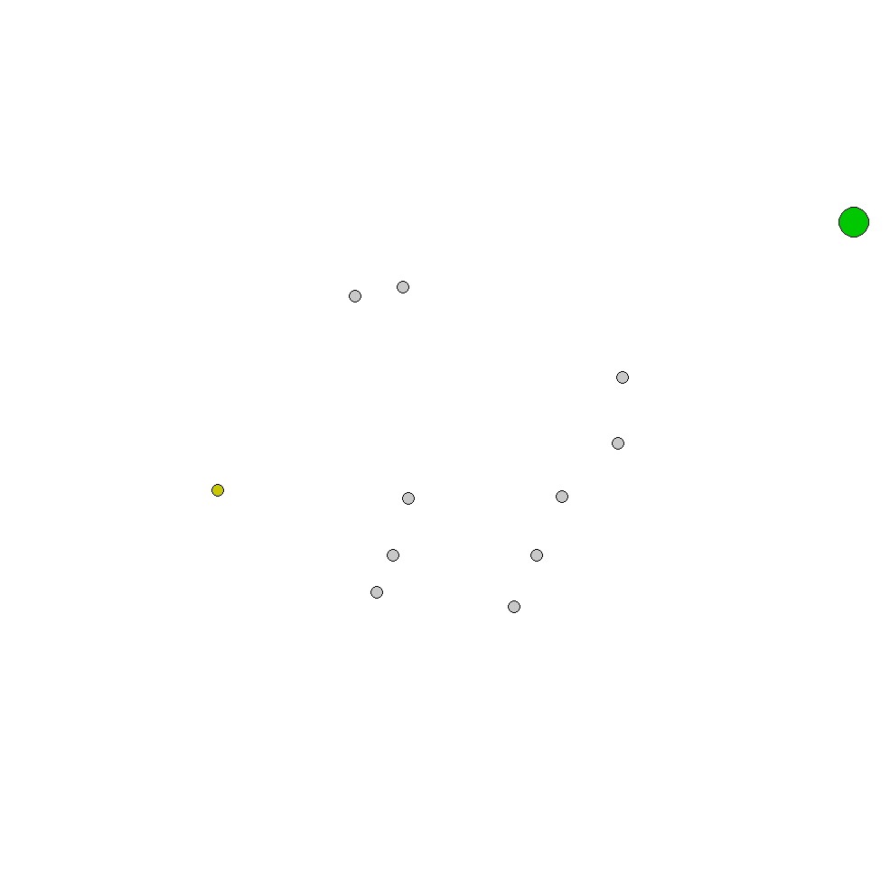
Search and rescue
Task:
Interact with a hostage then carry it to a goal zone
Goal:
Prepare an environment
Compare different methods
Difficulties:
pettingZoo
Env difficulty

Slide 3
Environment – SAR_v1
Multiple agents
Single goal (landmark)
Single hostage (landmark)
Limited visibility (no data)

Slide 4

Limited visibility
Creating a fog-like structure:
Fill screen with small tiles
Agents in range destroy tiles and gain rewards
Used to train exploration in a limited-visibility env
Wasn’t fully tested due to pettinZoo’s limitations

Slide 5
Observation space
Full visibility:
Agent position
Agent velocity
Target position
Active flag

Slide 6
Importance of observations space
Agents were particularly sensitive to excess information
Agents will avoid touching targets directly if they’re given position information of the other landmarks
Too little information forces the agents to predict the locations
The agents would swarm in the most rewarding region by guessing: the center

Slide 7
Methods used
From stable-baselines3
DQN
RPPO
PPO

Slide 8
PPO – DQN on 300k steps

Slide 9



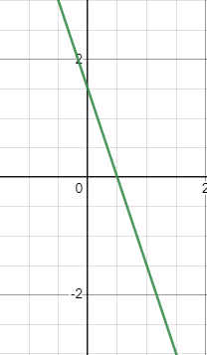
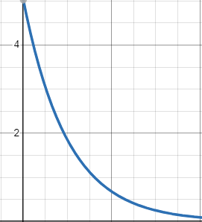
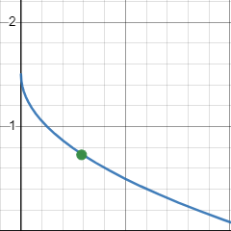
Rewards
Heuristic ( target_position, agent_position )
Rewards agent based on distance
Attempted functions:
Most successful, even among variants

Slide 10
Rewards - cont
Gradual rewards are given based on agent’s target
Flat rewards
medium for touching a hostage : all agents become active
high for touching the goal while active : resets the game
Limited space rewards: gradual rewards for reaching new tiles
Reached tiles get marked and stop giving rewards or drawing

Slide 11
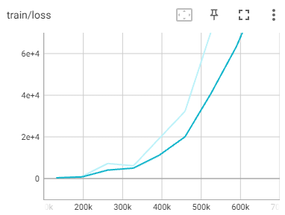
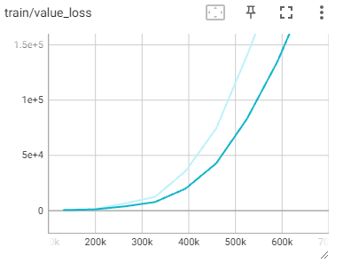
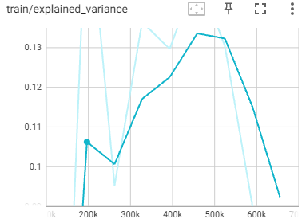
Tensorboard data ppo-600k
Batch size : 256
Lr : 0.001
Entropy coef : 0.01
Time metrics weren’t that relevant
Agents either solve tasks in a relatively similar time, or they struggle

Slide 12
Conclusion and Further Work
Conclusion
SAR is a multi-layered problem with many complex outcomes
Further Work
Independent MARL :
Limited visibility
Walls
Agent communication
Porting to other games

Slide 13
Thank You for Your attention!
Mraidi Mohamed Amin
v8po16@inf.elte.hu
Questions?

